Slide 1


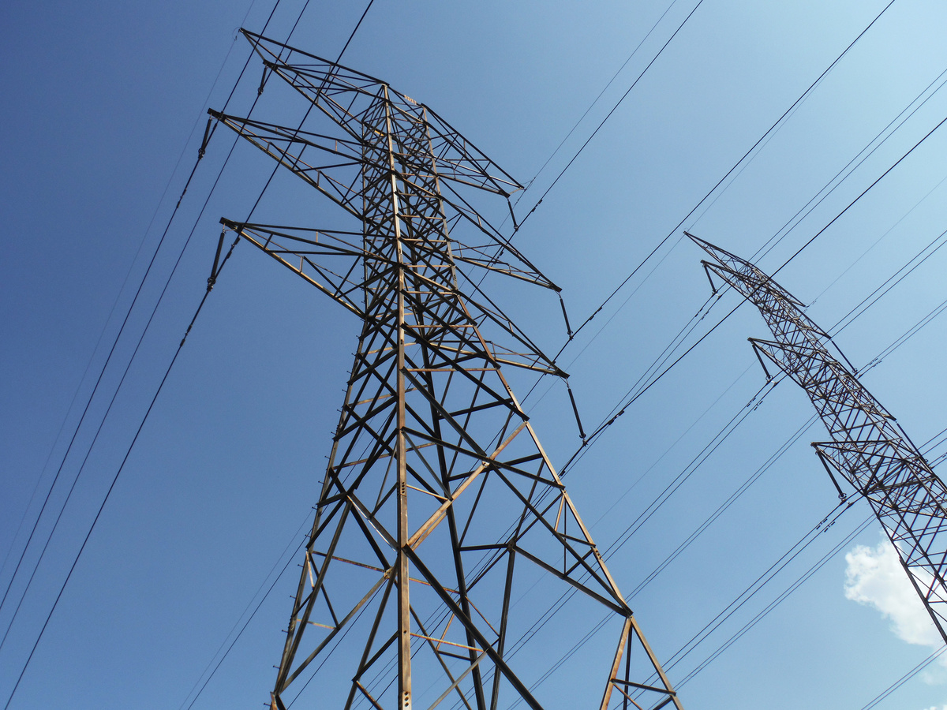
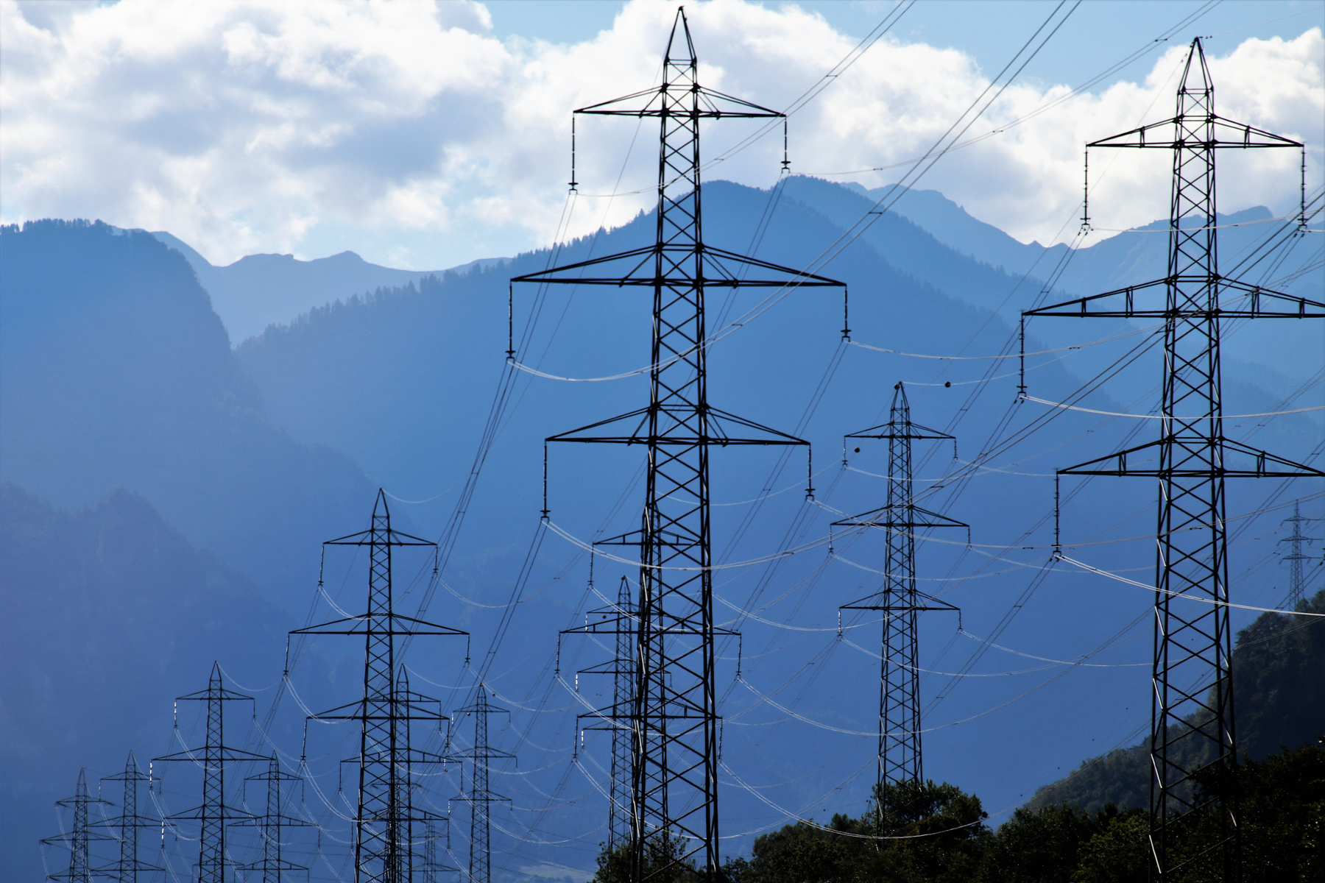
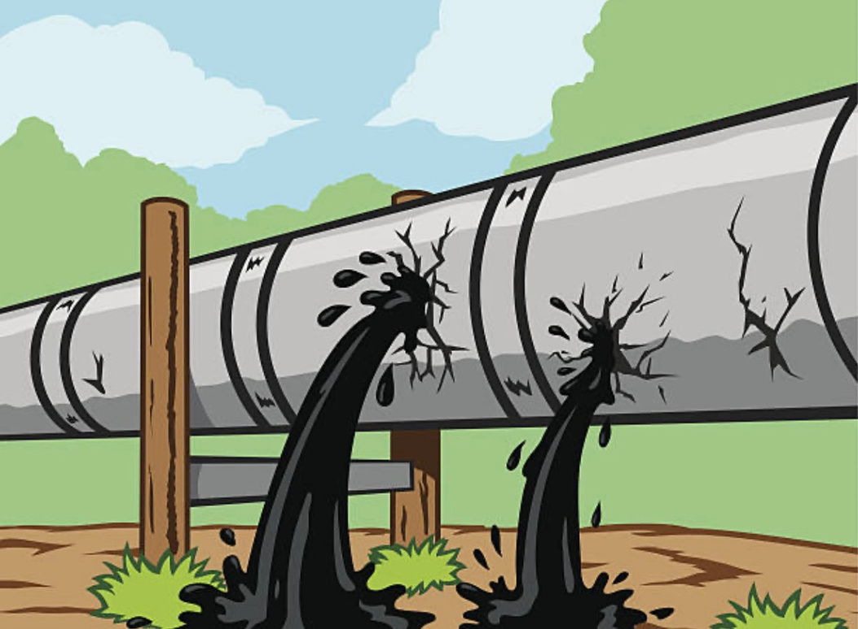

ELECTRICITY THEFT AND PIPELINE LEAKAGE
ENERGY AND OIL SECTOR
CONSTELLATION GROUP

Slide 2

Background
Major Problem in Both Developed and Developing Areas
Causes
*Illegal connections to powelines
*Undetected Leaks.
*Sytem overloads and cable Stealing
(causing fires, accidents, and power outages)

Slide 3


Current Detection = manual Inspection
•Slow
•Expensive
•Error Prone
•Detects after Damage

Slide 4

Overview
AI SOLUTION
-Unsupervised Machine Learning (anomaly detection)
Identifies
-Irregular patterns in energy and pipeline data

Slide 5

How IT workS!
•Trained on Normal data (Energy Consumption and Pipeline Pressure readings)
•Flags unknow/ unfit patterns as (Suspicious or abnormal)

Slide 6

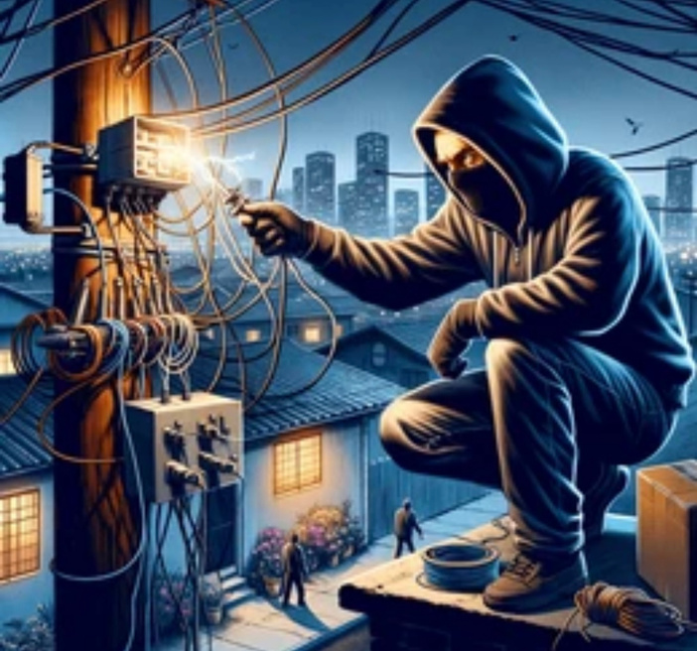
datasets
Datasets used:
for Electricity theft:
-SGCC (1037 columns 42 000 rows)
-frm 1st jan 2014 to 30 oct 2016
for Pipeline leakages:
-PHMSA (since 2010)

Slide 7
data processing
Remove missing values
Normalized data
Convert (time stamps to time series)
Visualize the trends
Split data

Slide 8

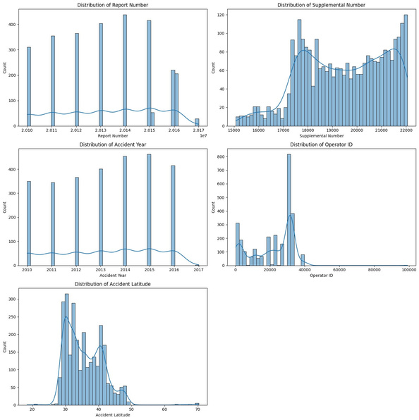
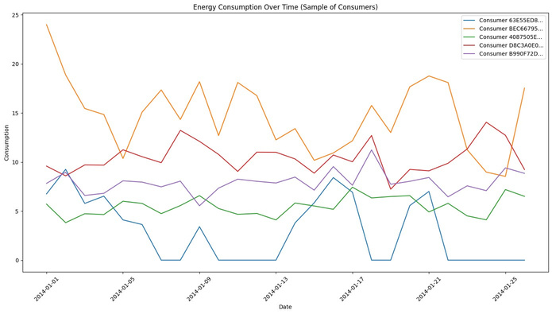
ML (UNSPERVISED)
Algorithms used:
Isolation Forest
K Means Clustering
Autoencoders
Standard Scaler

Slide 9

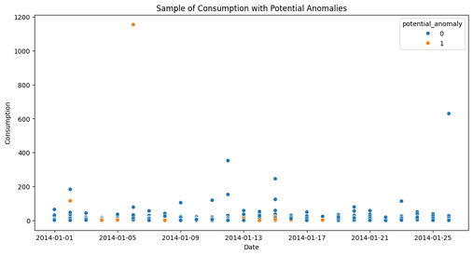
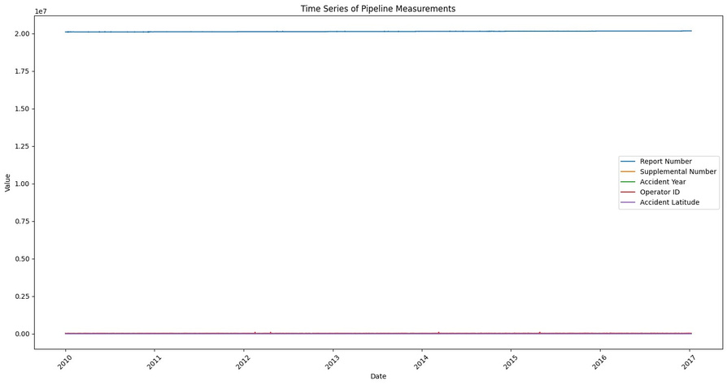
Results
analysis:
Graphs showing
Unusual spikes or drops(theft)
pressure drops(leaks)

Slide 10


Objectives and benefits
Reduce financial losses
Improve safety
Increase operational efficiency
Support sustainability

Slide 11
Tools and techniques
WE USED:
Python (on Google Colab)
Pandas and NumPy
Matplotlib
Scikit-learn

Slide 12
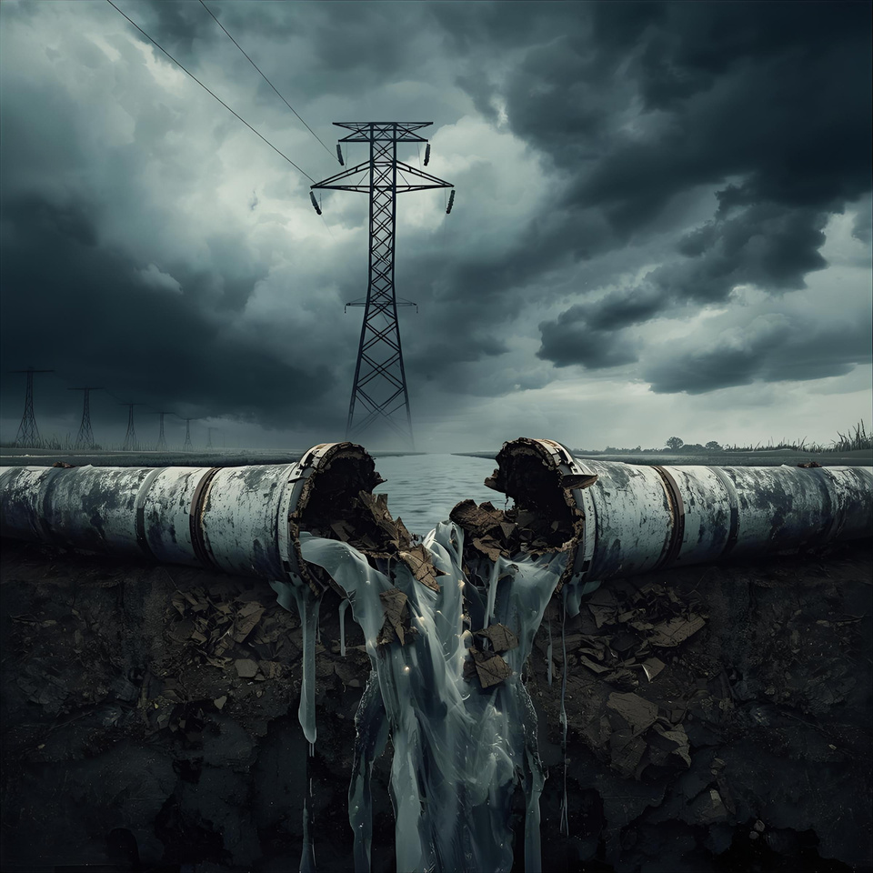
Risks and Constraints
Data availability: data is confidential
Accuracy: false positives
Computational cost: Large datasets= more processing power

Slide 13

Future improvements
include connecting real-time sensors and refining the model with more diverse data.

Slide 14
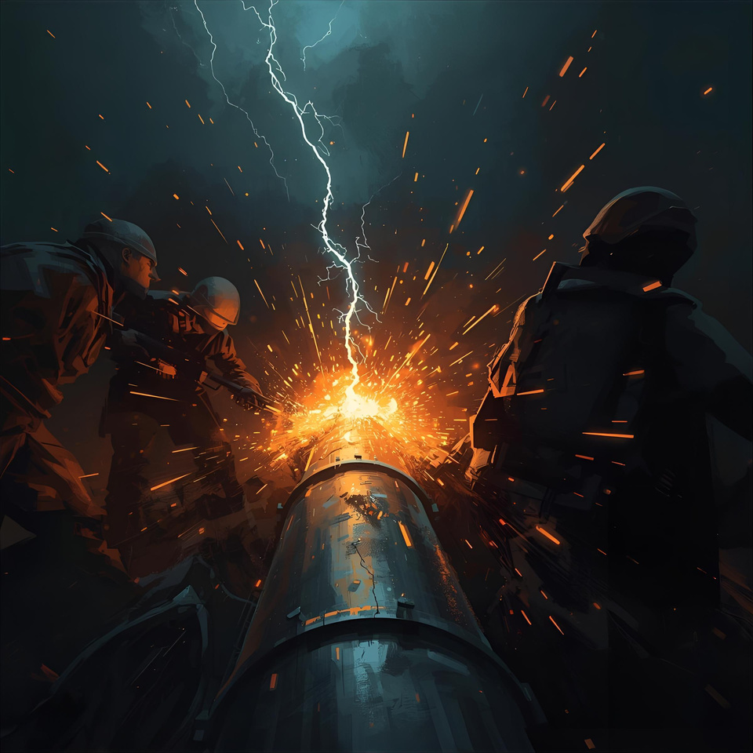
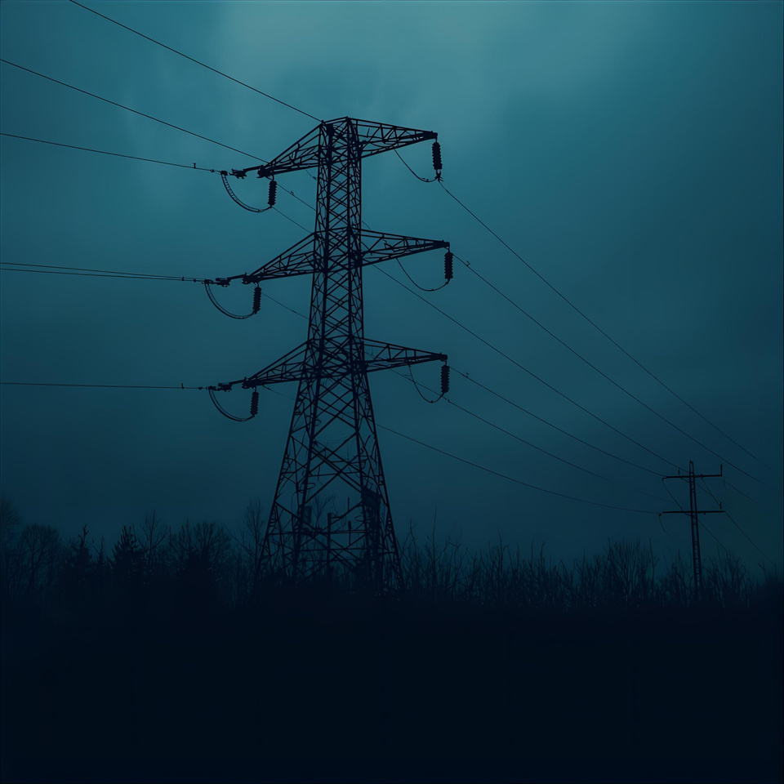
THANK YOU!

